Slide 1
FaceSwap using DeepFake
Team
Guanzhang Li
Wei Zhang
REFERENCES:
[1] Zhang J., Bargal S. A., Lin Z., Brandt J., Shen X., & Sclaroff S. (2018). Top-down neural attention by excitation backprop – International Journal of Computer Vision, 126(10), 1084-1102.
[2] Bargal S. A.*, Zunino A.*, Kim D., Zhang J., Murino V. and Sclaroff S. (2018). Excitation Backprop for RNNs – Proc. IEEE Conf. on Computer Vision and Pattern Recognition (CVPR).
[3] Zunino A.*, Bargal S. A.*, Morerio P., Zhang J., Sclaroff S., & Murino V. (2018). Excitation Dropout: Encouraging Plasticity in Deep Neural Networks – arXiv preprint arXiv:1805.09092.

Slide 2
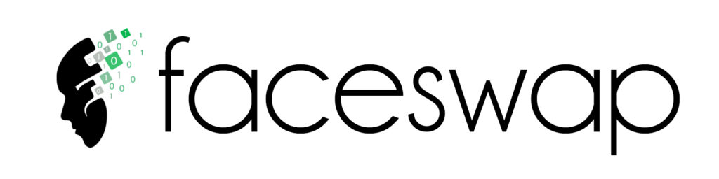
Motivation
The Algorithm and Ethics
Many people on the Internet use this technology wrongly, such as using photos to generate videos for extortion, and using celebrities to generate fake speeches to cause political problems.

Slide 3
Goal
Through the practice of this algorithm to explore more potential application scenarios and future development of this technology.
In this training, we used a limited set of photos of celebrities and tried to change faces.

Slide 4
Method: DeepFake
Step 1: Data Preprocessing
Step 2: Network Model
Step 3: Image Fusion

Slide 5
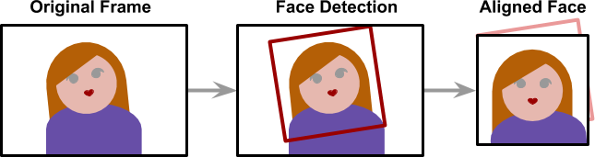
Step 1: Data Preprocessing
In DeepFake, we need to extract the face feature first. The face detection techniques are used here.
After detecting the face and feature points, the face in the image is centered and aligned.

Slide 6
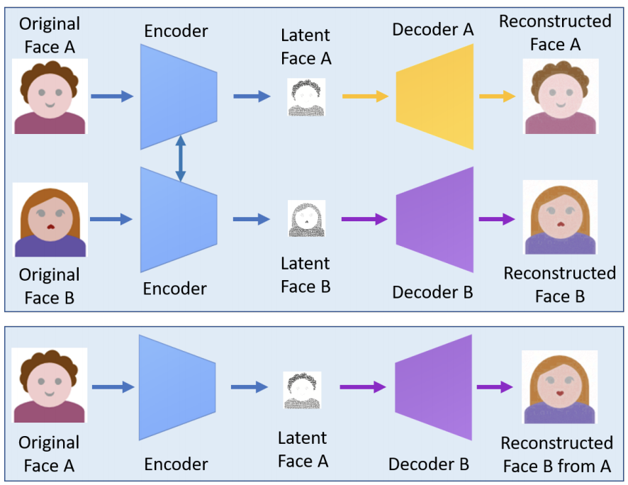
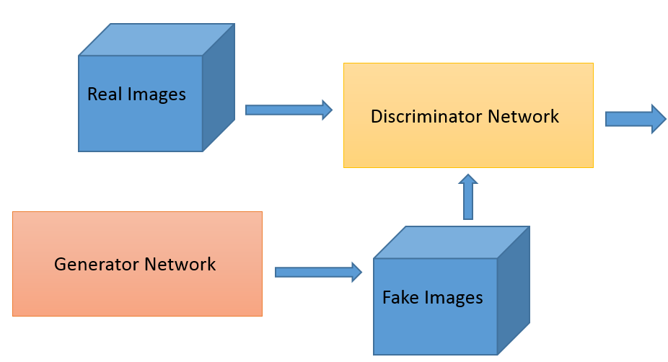
Step 2: Network Model
Autoencoder
Generative Adversarial Network(GAN)
Notes:
In that method, the autoencoder extracts latent features of face images and the decoder is used to reconstruct the face images. To swap faces between source images and target images, there is a need of two encoder-decoder pairs where each pair is used to train on an image set, and the encoder’s parameters are shared between two network pairs. In other words, two pairs have the same encoder network. This strategy enables the common encoder to find and learn the similarity between two sets of face images, which are relatively unchallenging because faces normally have similar features such as eyes, nose, mouth positions.
By adding adversarial loss and perceptual loss implemented in VGGFace [37] to the encoder-decoder architecture, an improved version of deepfakes based on the generative adversarial network (GAN) [38], i.e. faceswap-GAN, was proposed in [39]. The VGGFace perceptual loss is added to make eye movements to be more realistic and consistent with input faces and help to smooth out artifacts in segmentation mask, leading to higher quality output videos. This model facilitates the creation of outputs with 64x64, 128x128, and 256x256 resolutions. In addition, the multi-task convolutional neural network (CNN) from the FaceNet implementation [40] is introduced to make face detection more stable and face alignment more reliable. The CycleGAN [41] is utilized for generative network implementation. Popular deepfake tools and their typical features are summarized in Table I.

Slide 7
Train a GAN (Generative Adversarial Network)
Step 1: Initiate Generator and Discriminator
Step 2: Do not change the parameters in the Generator, only update the parameters in the Discriminator. Then randomly select some data from the Generator, and the original data-set.
Step 3: Do not change the parameters in the Discriminator, only update the parameters in the Generator. Generate a output, then put it into the Discriminator to get a score. The goal is to get higher score.

Slide 8
Architecture
Person 1 image
cnn
encoder
Decoder 1
Reconstructed
Person 1 image
GAN
Person 2 image
cnn
Decoder 2
Reconstructed Person 2 image
encoder
Person 2 image
Decoder 1
Reconstructed
Person 1 image
encoder
Person 1 image
Decoder 2
Reconstructed Person 2 image

Slide 9
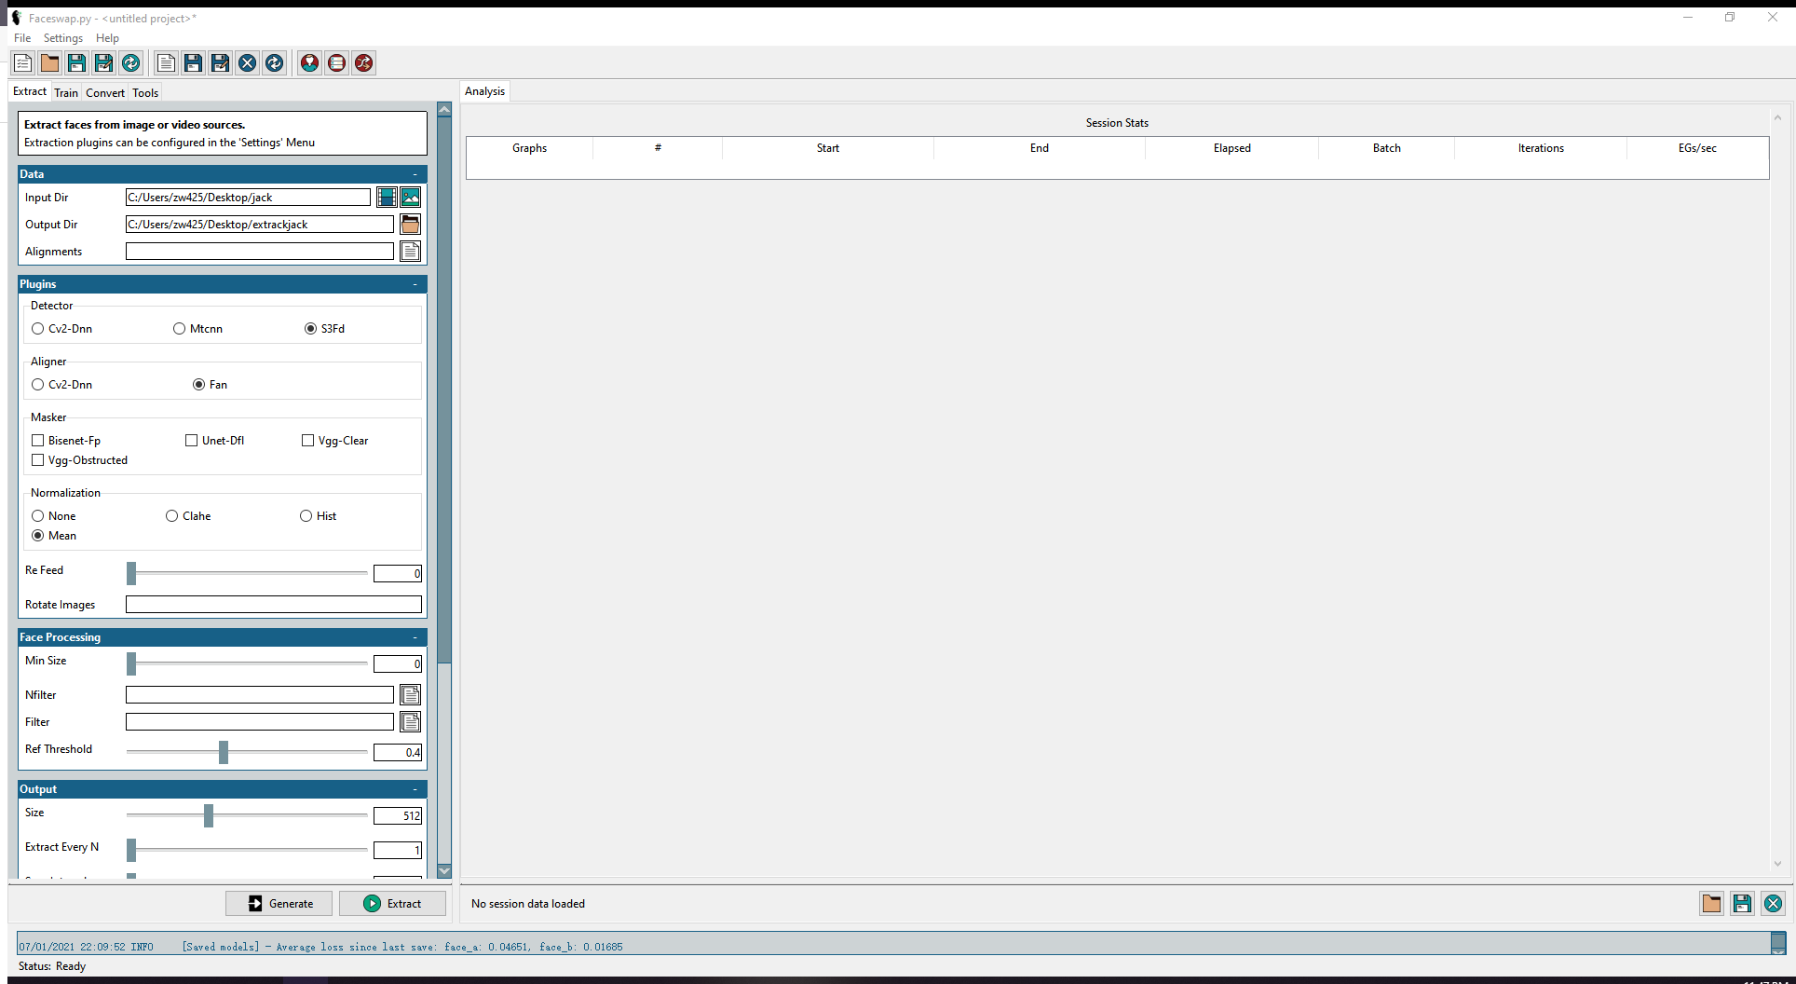
Training Details
GUI for faceswap

Slide 10
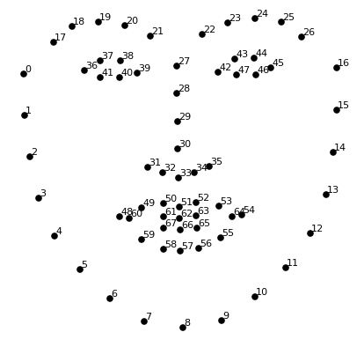
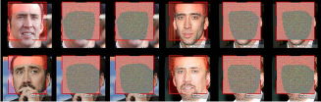
Extract,Train and Convert
Extract
1.Detection - Process of finding the faces within a frame
2.Alignment - Find landmarks within a face.
3. Mask generation - Identify the parts of an aligned face and block out the obstructions/backgrounds
-Location of the face
-User generated masks

Slide 11
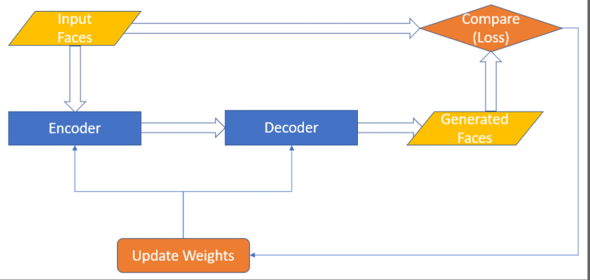
Train
-Encoder and decoder
-Loss and weights
ssim - structural similarity

Slide 12
Convert
Input Directory
Alignments File
Model Directory

Slide 13
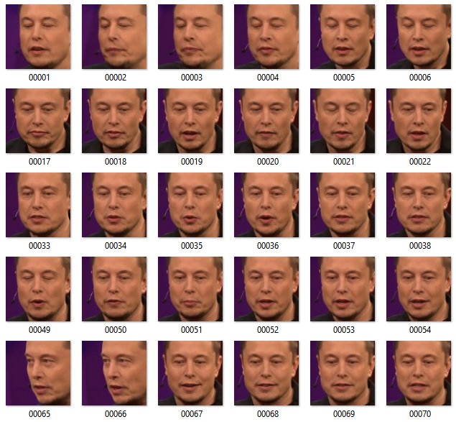
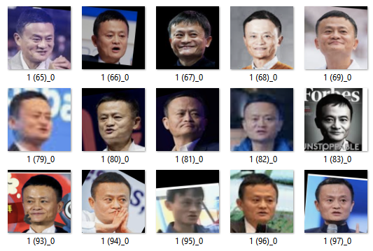
Experimental training and results
Dataset

Slide 14
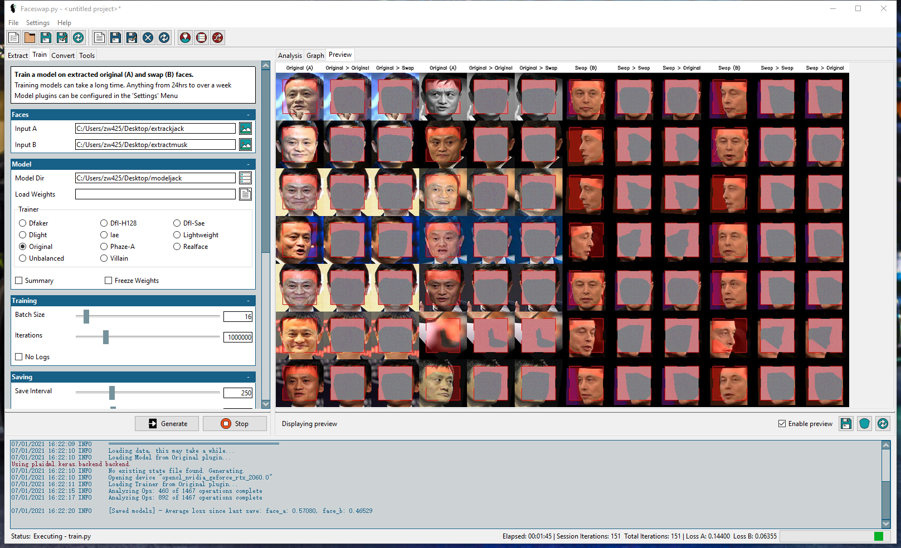
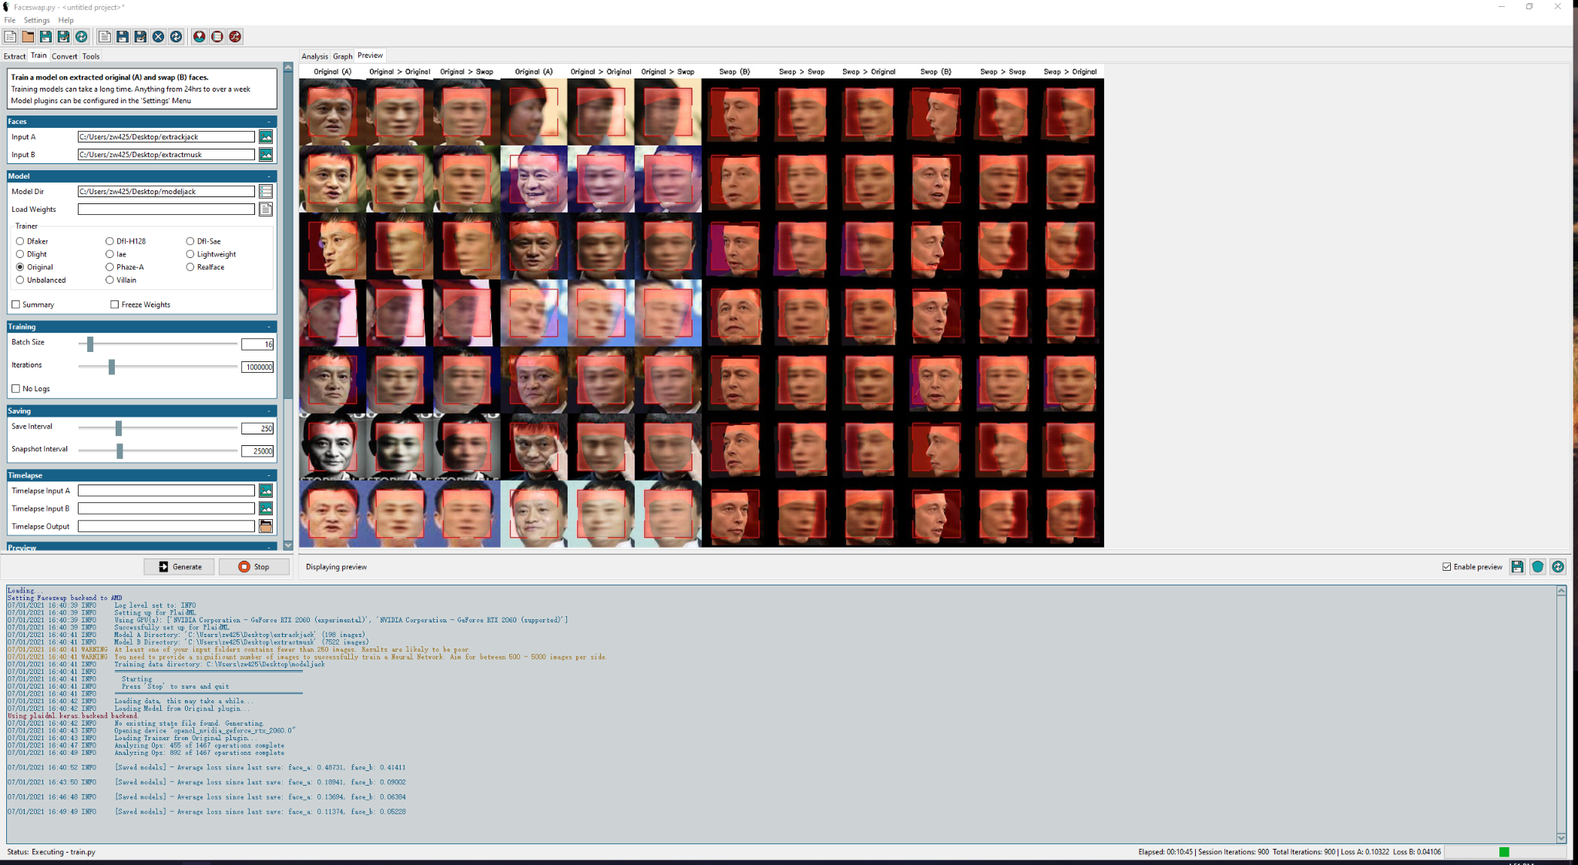
Training
First 250 iteration: Face_A loss: 0.48731 Face_B loss:0.41411
First 500 iteration: Face_A loss: 0.18941 Face_B loss:0.9002
First 750 iteration: Face_A loss:0.13694 Face_B loss:0.06384

Slide 15
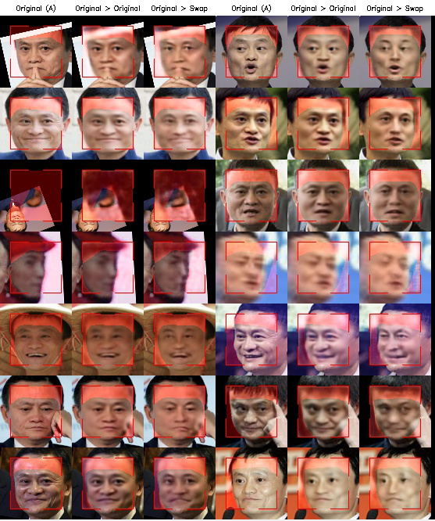
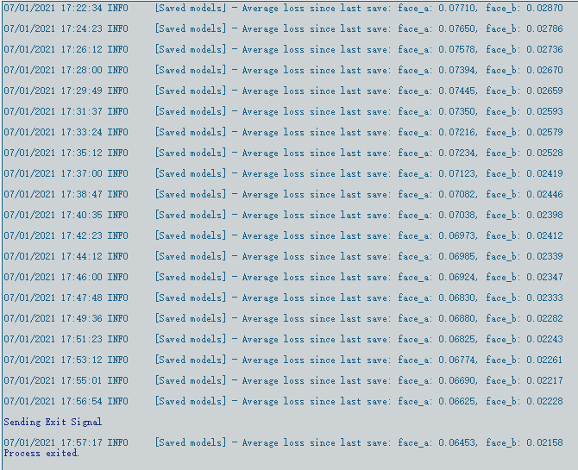
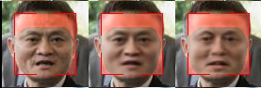
Results
Final loss: Face_A:0.06625 Face_B:0.02228
30000 iterations

Slide 16
Github reference to faceswap
https://github.com/deepfakes/faceswap

Slide 17
Reference
Zucconi, A. (2018, March 14). An Introduction to DeepFakes. Alan Zucconi. https://www.alanzucconi.com/2018/03/14/introduction-to-deepfakes/
Nguyen, Thanh & Nguyen, Cuong M. & Nguyen, Tien & Nguyen, Duc & Nahavandi, Saeid. (2019). Deep Learning for Deepfakes Creation and Detection: A Survey.
Brownlee, J. (2019, July 19). A Gentle Introduction to Generative Adversarial Networks (GANs). Machine Learning Mastery. https://machinelearningmastery.com/what-are-generative-adversarial-networks-gans/

